Slide 1
What is good performance measurement practice?
And how do we make performance measurement easier, faster, more engaging and meaningful?
Notes:
Most of our struggles with performance measurement are caused by bad KPI habits.
The bad KPI habits are the common ways that people choose, create and use performance measures, but consequently, those measures are not meaningful and not used.
PuMP is a methodology that describes an alternative to the bad KPI habits. It is a series of 8 steps that each provide a practical technique to replace the bad KPI habits.
What we’re going to do now is explore the differences between poor performance measurement practice and good practice.
SEGUE:
We’ll do this with a discussion tool called the PuMP Diagnostic.

Slide 2
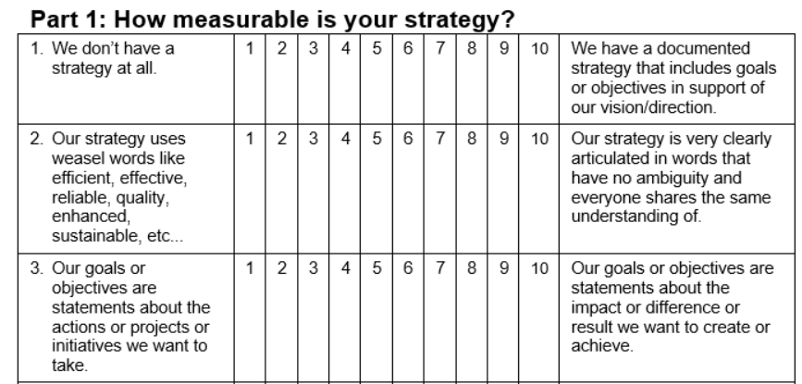
PuMP Diagnostic Discussion Tool
Notes:
The PuMP Diagnostic has 26 criteria.
Each criterion describes one element or part of a complete performance measurement process or approach.
The first one here describes the existence of a strategy or set of goals. That’s because performance measurement really needs to start with a clear goal to measure.
The left hand side describes poor practice, such as “We don’t have a strategy at all.”
The right hand side describes good practice, such as “We have a documented strategy that includes goals or objectives in support of our vision/direction.”
PuMP is the collection of good practices, on the right hand side.
There is an ‘agreement’ scale for each of the 26 criteria of performance measurement.
The left hand side is poor practice, and starts at 1.
The right hand side is good practice, and ends at 10.
And we can choose our ratings either by averaging individual ratings or by consensus. I’m going to recommend we average individual ratings, and only spend more time discussing them if we find a lot of variation in our individual ratings along the scale.
[Handout a copy of the Diagnostic to each participant, so they can follow along.]
By reading each criterion together, in discussion, we’ll get a good understanding of what good performance measurement practice is.
And by rating each criterion together, in discussion, we’ll get a good understanding of how much potential we have to improve our performance measurement approach.
We could also use this to set our baseline of current performance measurement maturity, to compare with another diagnostic we could do after we’ve implemented PuMP.
SEGUE:
While we have the PuMP Diagnostic Discussion, we will capture each rating in a spread sheet…

Slide 3
We’ll capture our discussion in a spreadsheet
Notes:
For each of the PuMP Diagnostic criteria, we’ll capture our ratings in a spreadsheet, that will automatically calculate our averages.
But the important thing is our discussion – not the ratings!
Let’s get started…
[Open the PuMP Diagnostic Discussion Tool spreadsheet]
INSTRUCTIONS:
Decide the unit of the organisation to apply the Diagnostic to.
Whole organisation?
Executive team? A specific department or business unit?
For each of the 26 criteria (aim for 2 minutes each, so the discussion is limited to 1 hour):
Read out the poor practice and then the good practice.
Check if everyone understands it. Have a very brief discussion of it’s meaning, if necessary.
Invite everyone to choose a rating for where the unit currently sits, and they can circle this on their copy of the Diagnostic.
Have everyone share their rating, and keep a tally in the spreadsheet, on the appropriate worksheet.
If there are any extreme ratings that differ from the majority, briefly discuss the reasoning of the person who have the rating. Sometimes this can be a clue of misunderstanding or lack of knowledge. Revise the rating if desired.
Note the average rating calculated for that criterion.
When all the ratings are captured, go to the Summary worksheet.
Explain how PuMP can be used to close the gaps between where they currently sit and the good practices.
Ask for their reactions (thoughts or feelings or ideas or insights) to the results.
Discuss next steps. Will they:
Schedule PuMP training for performance measurement ‘champions’ around the organisation?
Schedule a PuMP Pilot, to test out PuMP on just one or two goals?
Start applying PuMP now, to the strategic goals (before cascading to the rest of the organisation)?
Something else?
Close the session.

